Slide 1



KS3 Mathematics
S5 Scale Drawing
Notes:
The aim of this unit is to teach pupils to:
Understand and use the language and notation associated with translations
Recognise and visualise transformations of 2-D shapes
Use and interpret maps and scale drawings
Material in this unit is linked to the Key Stage 3 Framework supplement of examples pp 203, 205, 212-217.

Slide 2
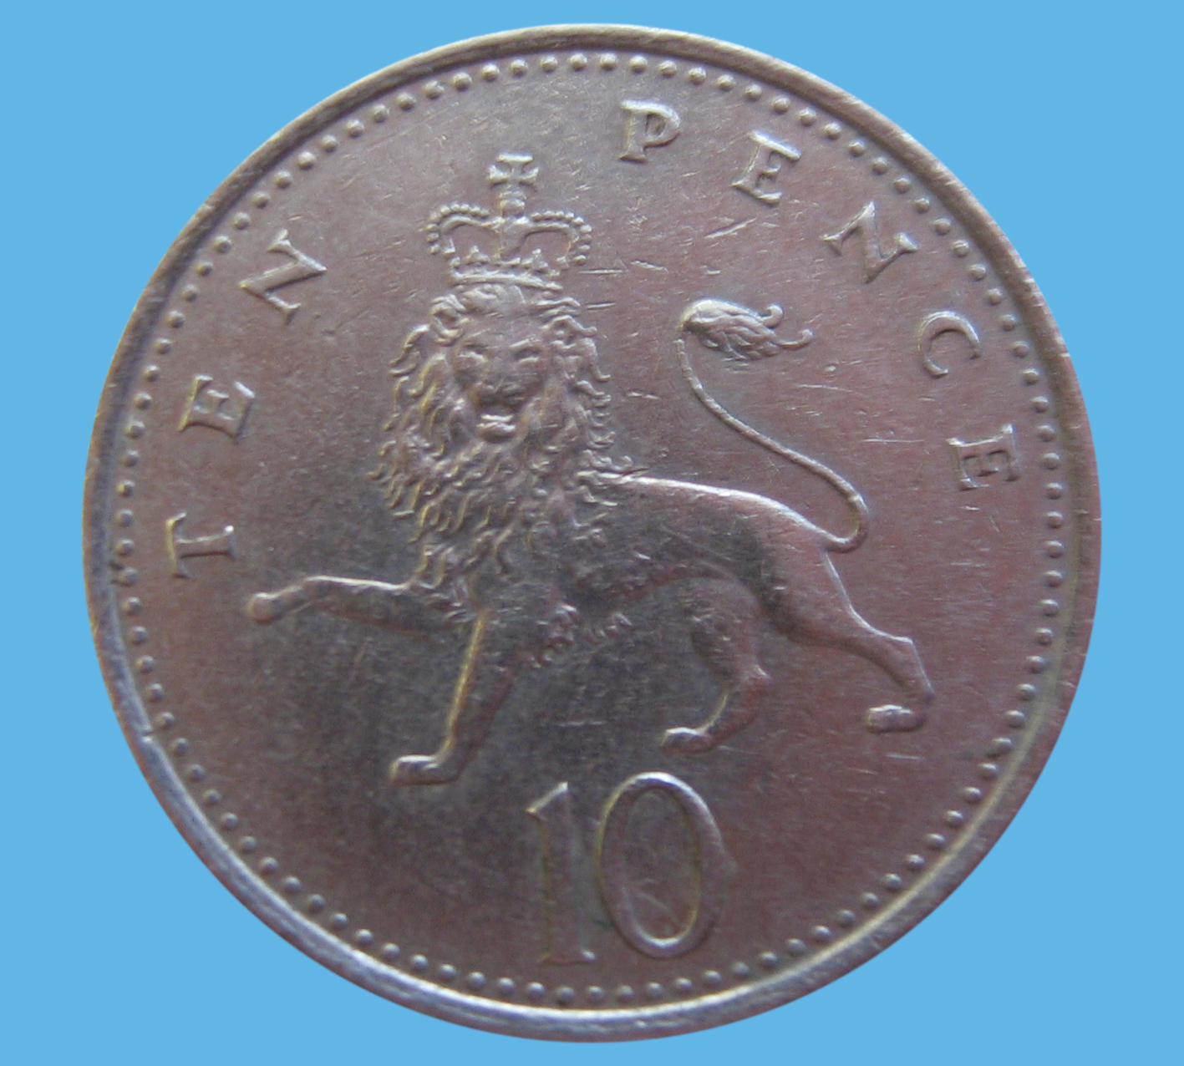


Scale drawings
We use scale drawings to represent real objects drawn in proportion to their actual sizes.
If we are given a scale for a picture then we can work out the size of an object in real life.
For example, this is a scale picture of a 10p coin.
0.5 cm in this picture represents 1 mm in real life.
The coin in the picture has a diameter of 12.2 cm. What is the actual diameter of the coin?
The actual diameter is 24.4 mm.
Notes:
Explain that in scale drawings objects are usually scaled down so that they fit on the page. Occasionally a small object can be scaled up as shown in this example.
To find the actual size of the coin we have to divide 12.2 cm by 0.5 to give 24.4 mm.
You may want to edit the numbers here so that the scale is correct for the set-up of your display.

Slide 3
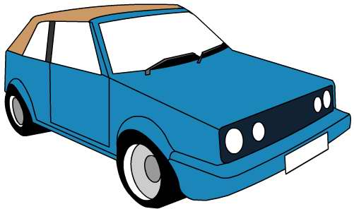
Scale drawings
Here is a scale drawing of a car.
Every 1 cm in this drawing represents 50 cm in real life.
If the length of the car in the drawing is 4.5 cm, what length is the car in real life?
Length of the car in real life =
4.5 × 50
= 225 cm
= 2.25 m
Notes:
Establish that to find the length of the car in real life, we have to multiply the 4.5 cm by 50.

Slide 4
Drawing a plan
On maps and plans, the scale is usually given as a ratio.
For example, Frank decides to draw a plan of his bedroom using a scale of 1 : 20.
That means that every 1 cm in the plan represents 20 cm or 0.2 m in real life.
He measures his room to find that it has a length of 360 cm and a width of 250 cm.
What will the length and the width of the room be in the scale drawing?
Length = 360 ÷ 20 =
18 cm
Length = 250 ÷ 20 =
12.5 cm

Slide 5
Drawing a plan
Frank uses a table to convert between the sizes of the things in his room and their sizes in his plan:
Object
Actual size
Size in the plan
Width of door
80 cm
4 cm
Bed
90 cm by 190 cm
4.5 cm by 9.5 cm
Chest of drawers
68 cm by 52 cm
3.4 cm by 2.6 cm
Wardrobe
120 cm by 50 cm
6 cm by 2.5 cm
Desk
36 cm by 64 cm
1.8 cm by 3.2 cm
Bookshelf
35 cm by 78 cm
1.75 cm by 3.9 cm
Notes:
Establish that to find the size in the plan, given the actual size we have to divide by 20. To find the actual size, given the size in the plan we have to multiply by 20.

Slide 6
Maps
A map uses a scale of 1 : 40 000.
How many km are represented by 1 cm on the map?
1 cm on the map is 40 000 cm in real life.
40 000 cm = 400 m
= 0.4 km
1 cm on the map is 0.4 km in real life.
Two towns are 3.5 cm apart on the map.
How far apart are they in real life?
3.5 cm × 0.4 =
1.4 km
Notes:
Point out that when converting a large number of centimetres to kilometres it is often easier to first convert to metres by dividing by 100 and then to convert the metres to kilometres by dividing by 1000.
Once we have worked out that 1 cm on the map is 0.4 km in real life we can multiply any distance given in cm on the map by 0.4 to find the distance in km.

Slide 7
Maps
A map uses a scale of 1 : 50 000.
How many km are represented by 1 cm on the map?
1 cm on the map is 50 000 cm in real life.
50 000 cm = 500 m
= 0.5 km
1 cm on the map is 0.5 km in real life.
Two towns are 2.3 km apart in real life.
How far apart are they on the map?
2.3 km ÷ 0.5 =
4.6 cm
Notes:
Once we have worked out that 1 cm on the map is 0.5 km in real life we can divide any distance given in km by 0.5 to find the distance represented in the map in cm.

